Slide 1
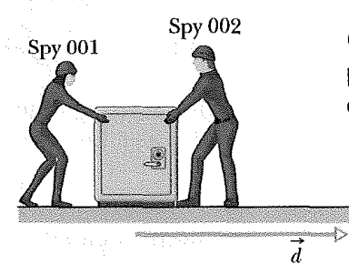
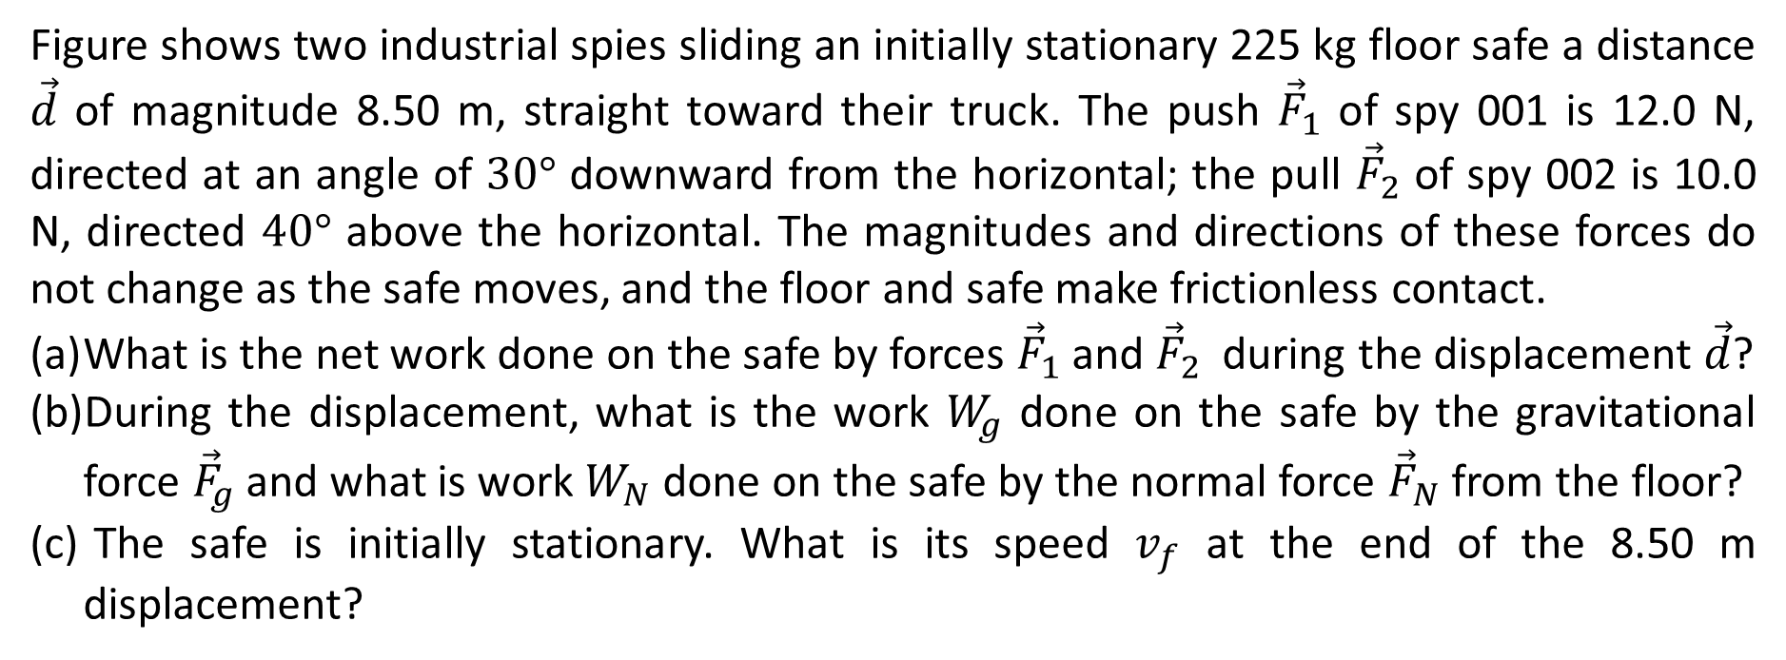
Figure shows two industrial spies sliding an initially stationary 225 kg floor safe a distance $\vec{d}$ of magnitude 8.50 m, straight toward their truck. The push ${\vec{F}}_{1}$ of spy 001 is 12.0 N, directed at an angle of $30°$ downward from the horizontal; the pull ${\vec{F}}_{2}$ of spy 002 is 10.0 N, directed $40°$ above the horizontal. The magnitudes and directions of these forces do not change as the safe moves, and the floor and safe make frictionless contact.
What is the net work done on the safe by forces ${\vec{F}}_{1}$ and ${\vec{F}}_{2}$ during the displacement $\vec{d}$?
During the displacement, what is the work $W_{g}$ done on the safe by the gravitational force ${\vec{F}}_{g}$ and what is work $W_{N}$ done on the safe by the normal force ${\vec{F}}_{N}$ from the floor?
The safe is initially stationary. What is its speed $v_{f}$ at the end of the 8.50 m displacement?

Slide 2
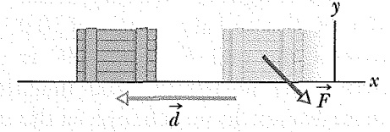
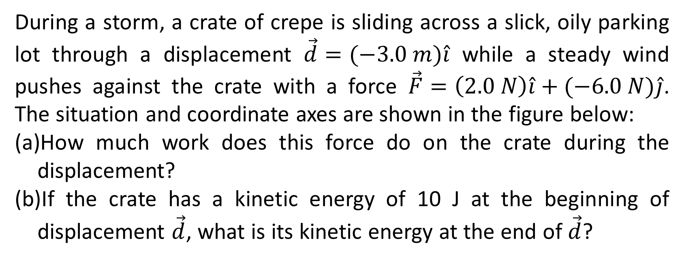
During a storm, a crate of crepe is sliding across a slick, oily parking lot through a displacement $\vec{d}=(−3.0 m)\hat{i}$ while a steady wind pushes against the crate with a force $\vec{F}=\left(2.0 N\right)\hat{i}+(−6.0 N)\hat{j}$. The situation and coordinate axes are shown in the figure below:
How much work does this force do on the crate during the displacement?
If the crate has a kinetic energy of 10 J at the beginning of displacement $\vec{d}$, what is its kinetic energy at the end of $\vec{d}$?

Slide 3
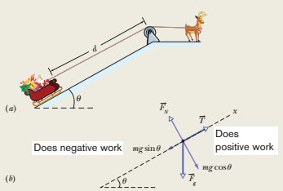
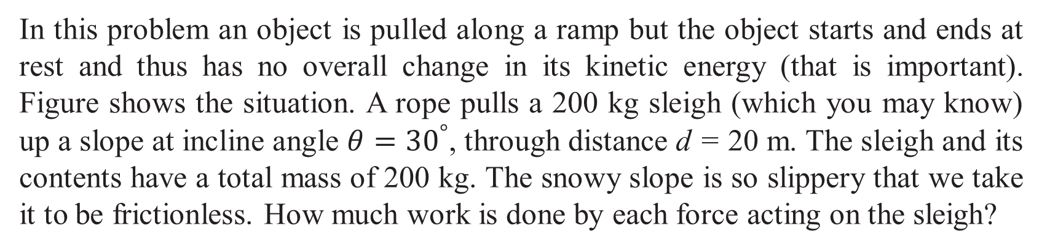
In this problem an object is pulled along a ramp but the object starts and ends at rest and thus has no overall change in its kinetic energy (that is important). Figure shows the situation. A rope pulls a 200 kg sleigh (which you may know) up a slope at incline angle $θ={30}^{°}$, through distance d = 20 m. The sleigh and its contents have a total mass of 200 kg. The snowy slope is so slippery that we take it to be frictionless. How much work is done by each force acting on the sleigh?

Slide 4
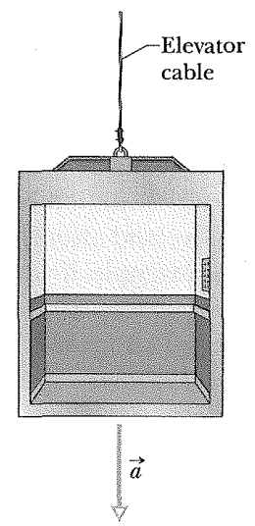
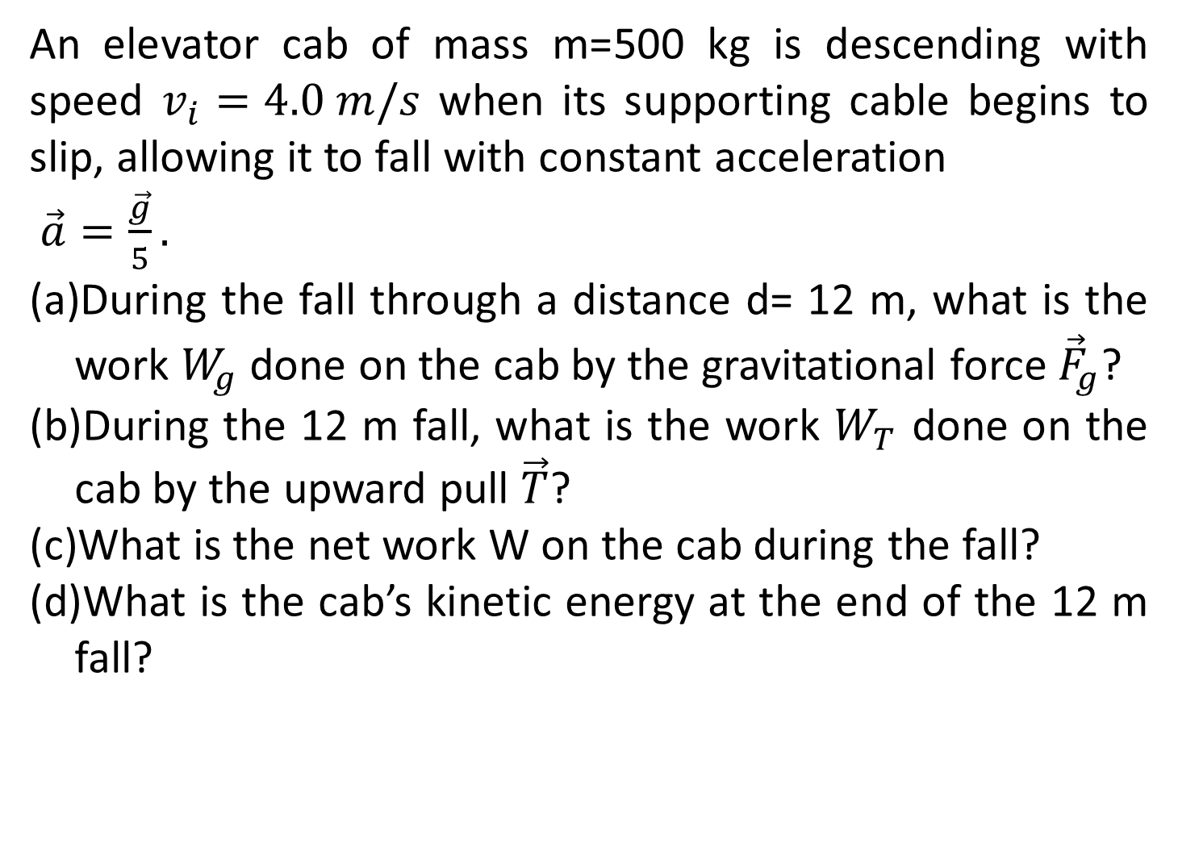
An elevator cab of mass m=500 kg is descending with speed $v_{i}=4.0 m/s$ when its supporting cable begins to slip, allowing it to fall with constant acceleration
$\vec{a}=\frac{\vec{g}}{5}.$
During the fall through a distance d= 12 m, what is the work $W_{g}$ done on the cab by the gravitational force ${\vec{F}}_{g}$?
During the 12 m fall, what is the work $W_{T}$ done on the cab by the upward pull $\vec{T}$?
What is the net work W on the cab during the fall?
What is the cab’s kinetic energy at the end of the 12 m fall?

Slide 5
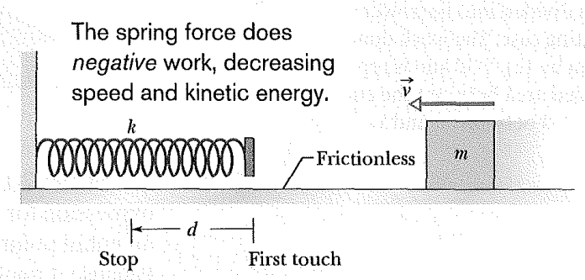
As in the figure, a cumin canister of mass m=0.40 kg slides across a horizontal frictionless counter with speed v=0.50 m/s. It then runs into and compresses a spring of spring constant k=750 N/m. When the canister is momentarily stopped by the spring, by what distance d is the spring compressed?

Slide 6
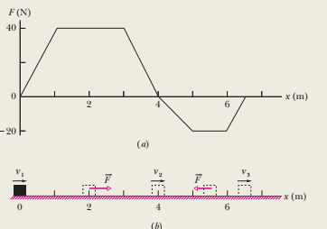
In Fig.-b an 8.0 kg block slides along a frictionless floor as a force acts on it, starting at x₁ and ending at x₃ = 6.5 m. As the block moves, the magnitude and direction of the force varies according to the graph shown in Fig.-a. For example, from x = 0 to x=1 m, the force is positive (in the positive direction of the x axis) and increases in magnitude from 0 to 40 N. And from x = 4 m to x = 5 m, the force is negative and increases in magnitude from 0 to 20 N. (Note that this latter value is displayed as -20 N.) The block’s kinetic energy at x₁ is K₁ = 280 J. What is the block’s speed at x1 0, x₂ = 4.0 m, and x₃ = 6.5 m?

Slide 7
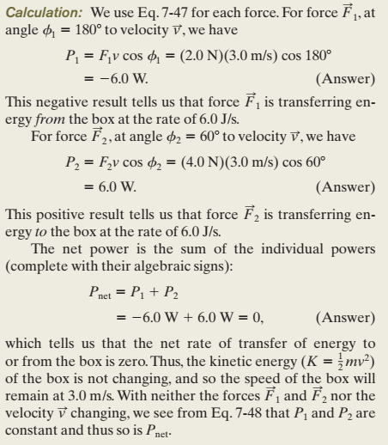
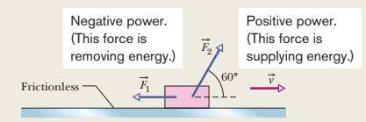
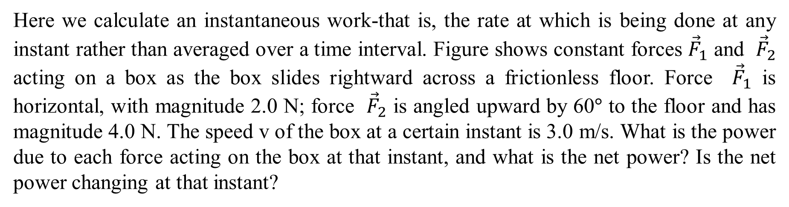
Here we calculate an instantaneous work-that is, the rate at which is being done at any instant rather than averaged over a time interval. Figure shows constant forces ${\vec{F}}_{1}$ and ${\vec{F}}_{2}$ acting on a box as the box slides rightward across a frictionless floor. Force ${\vec{F}}_{1}$ is horizontal, with magnitude 2.0 N; force ${\vec{F}}_{2}$ is angled upward by 60$°$ to the floor and has magnitude 4.0 N. The speed v of the box at a certain instant is 3.0 m/s. What is the power due to each force acting on the box at that instant, and what is the net power? Is the net power changing at that instant?

